Slide 1
Introduction to CNNs
Sungjoon Choi
(sungjoon.choi@cpslab.snu.ac.kr)

Slide 2
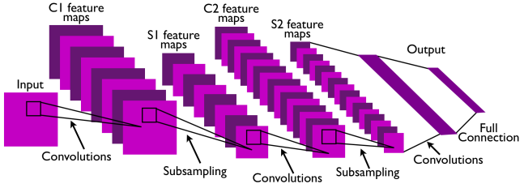
CNN
Convolutional Neural Network
This is pretty much everything about the convolutional neural network.
Convolution + Subsampling + Full Connection

Slide 3
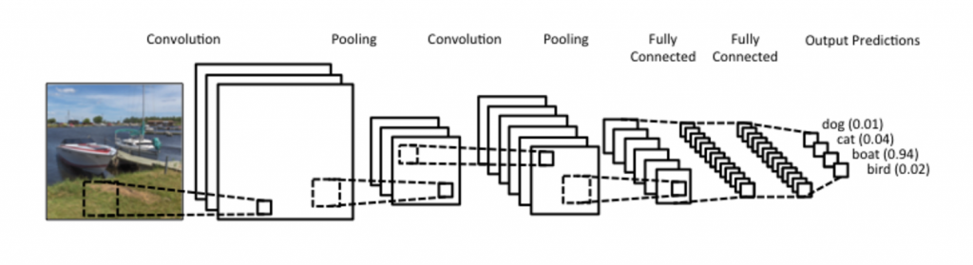
CNN
CNNs are basically layers of convolutions followed by subsampling and fully connected layers.
Intuitively speaking, convolutions and subsampling layers works as feature extraction layers while a fully connected layer classifies which category current input belongs to using extracted features.

Slide 4
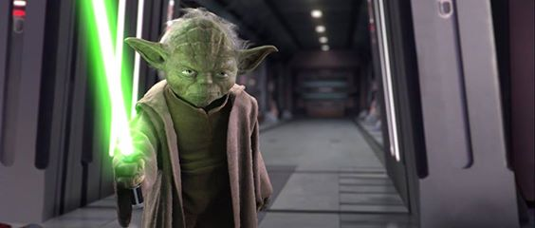
Why so powerful?
Local Invariance
Loosely speaking, as the convolution filters are ‘sliding’ over the input image, the exact location of the object we want to find does not matter much.
Compositionality
There is a hierarchy in CNNs. It is GOOD!
https://starwarsanon.wordpress.com/tag/darth-sidious-vs-yoda/

Slide 5
Convolution
커널의 모양
(위의 경우 움직이는 주홍색)은
학습을 하게됨
http://deeplearning.stanford.edu/wiki/index.php/Feature_extraction_using_convolution

Slide 6
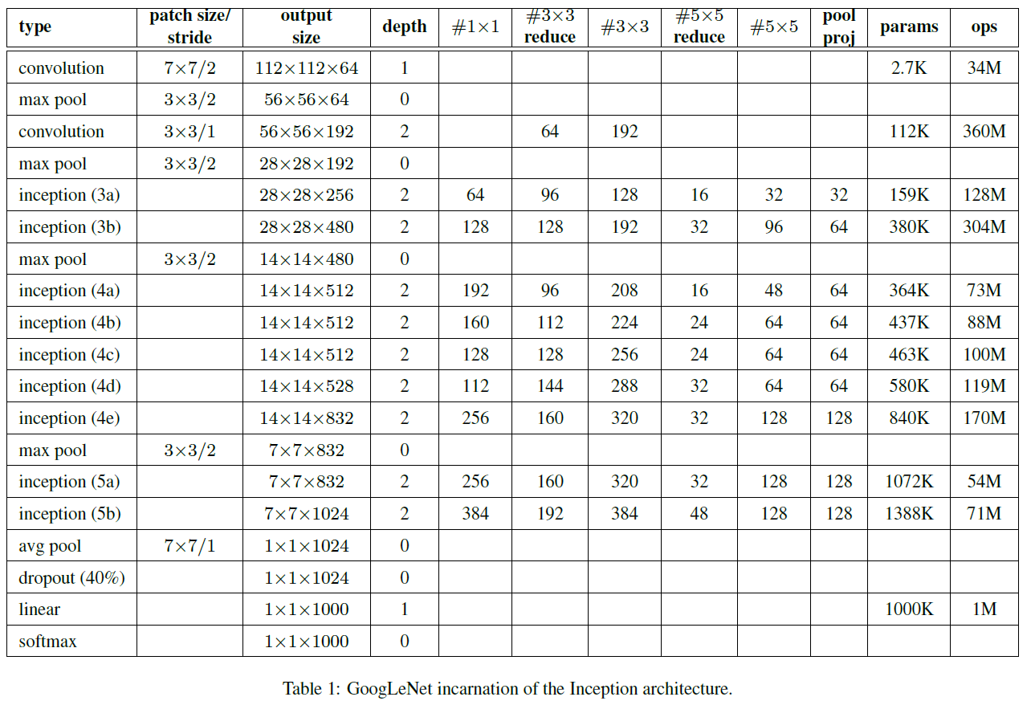

Get familiar with this
Zero-padding
Stride
Channel

Slide 7
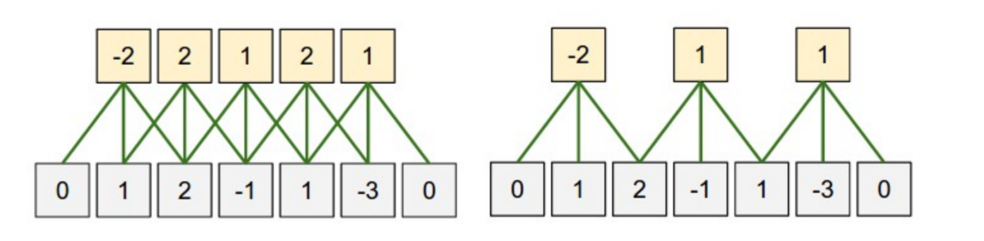





Zero-padding
What is the size of the input?
$n_{in}=5$
What is the size of the output?
$n_{out}=5$
What is the size of the filter?
$n_{filter}=3$
What is the size of the zero-padding?
$n_{padding}=1$
$n_{out}=\left(n_{in}+2∗n_{padding}−n_{filter}\right)+1$
$5=\left(5+2∗1−3\right)+1$

Slide 8
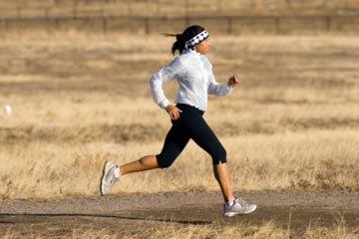
Stride

Slide 9
Stride
(Left) Stride size: 1
(Right) Stride size: 2
If stride size equals the filter size, there will be no overlapping.

Slide 10
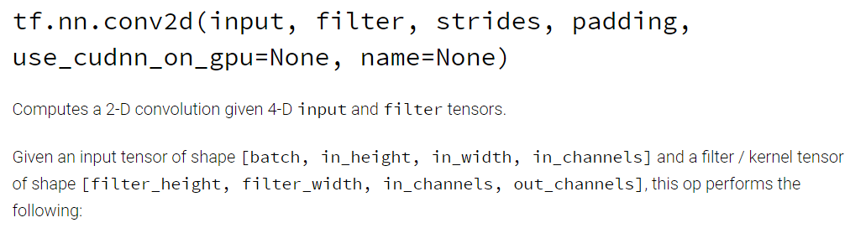
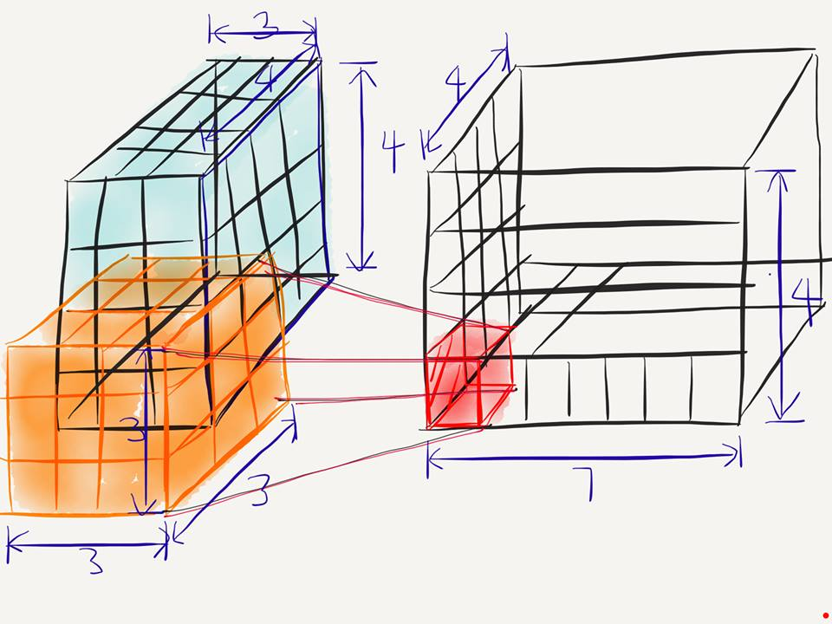
Conv2D
[batch, in_height, in_width, in_chnnel]
[filter_height, filter_width, in_channels, out_channels]
[batch, in_height=4, in_width=4, in_chnnel=3]
[filter_height=3, filter_width=3, in_channels=3, out_channels=7]

Slide 11
Conv2D
[batch, in_height=4, in_width=4, in_chnnel=3]
[filter_height=3, filter_width=3, in_channels=3, out_channels=7]
What is the number of parameters in this convolution layer?
파라미터는 매우 중요함
앞으로 강의에서 자주 말 할꺼임
→ $189= 3∗3∗3∗7$

Slide 12
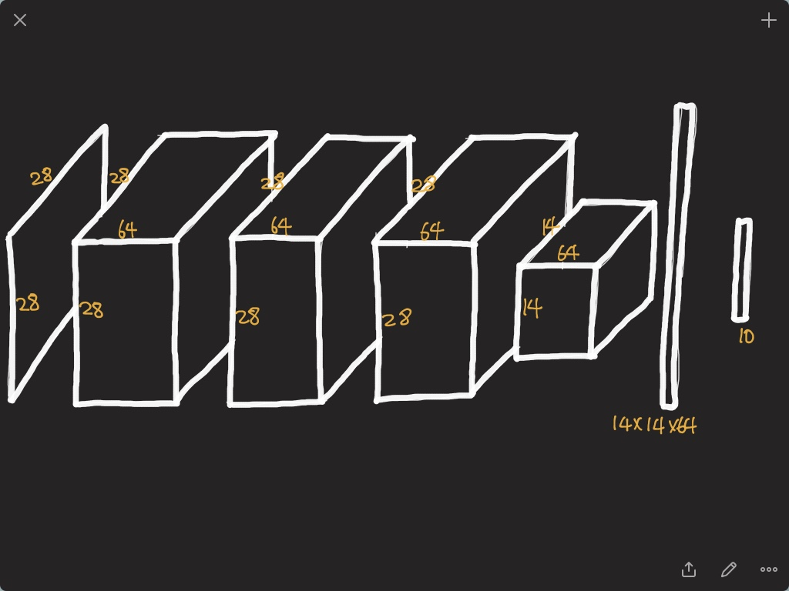

Slide 13
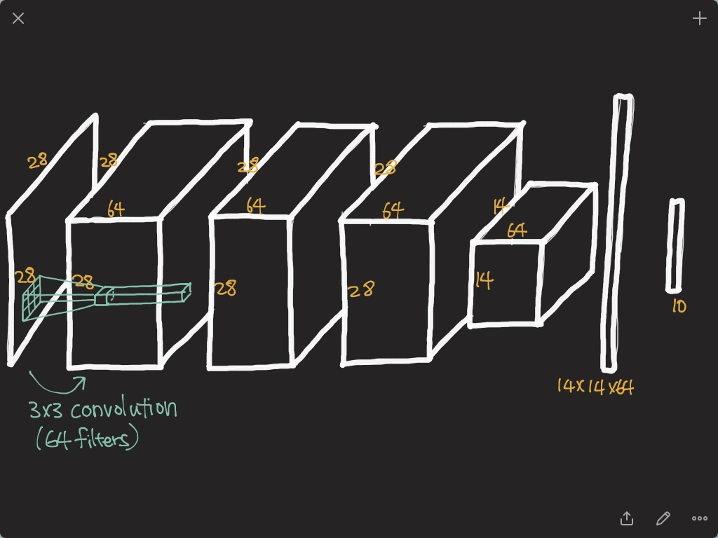

Slide 14
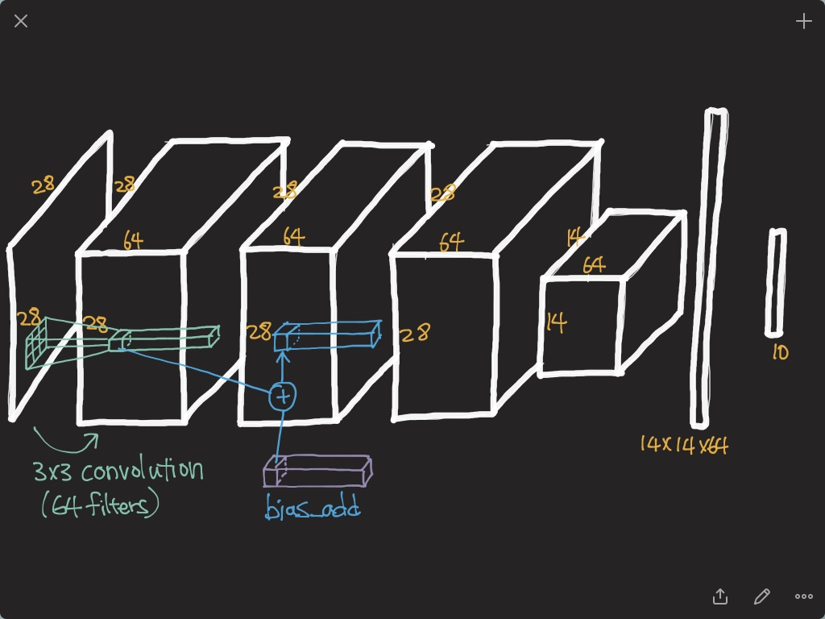

Slide 15
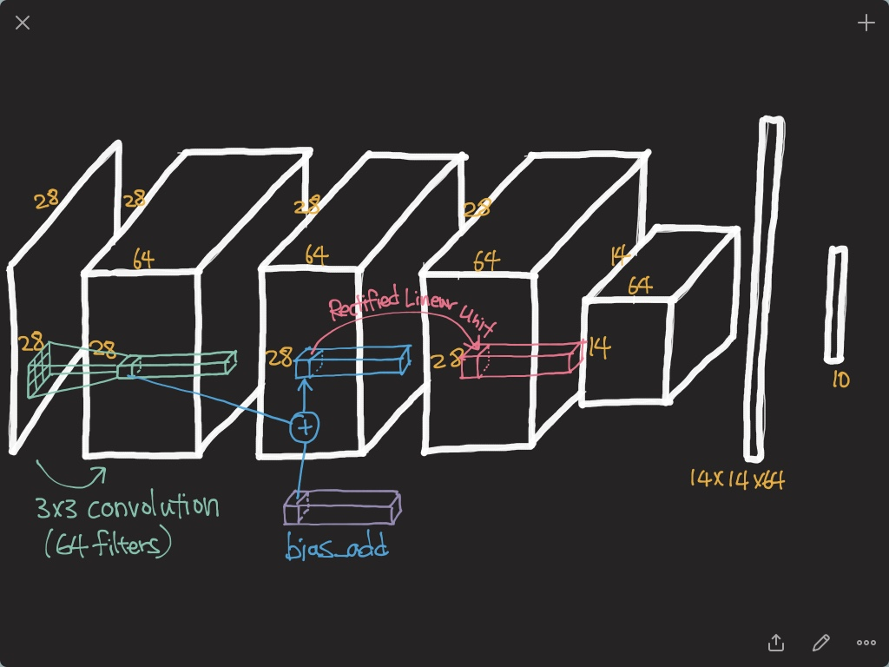

Slide 16
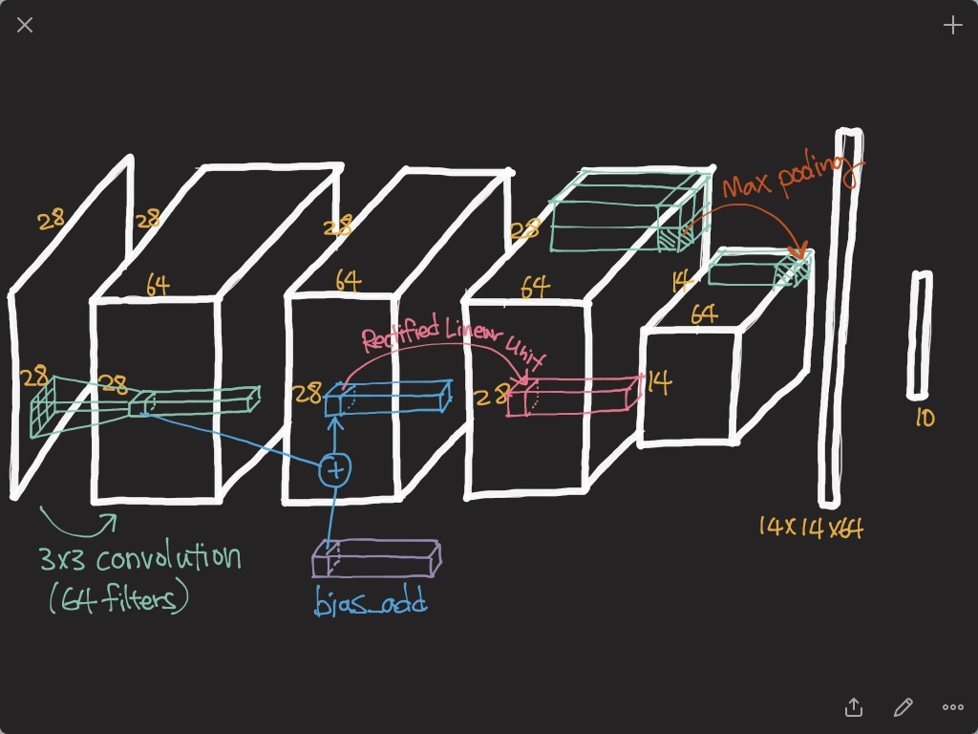

Slide 17
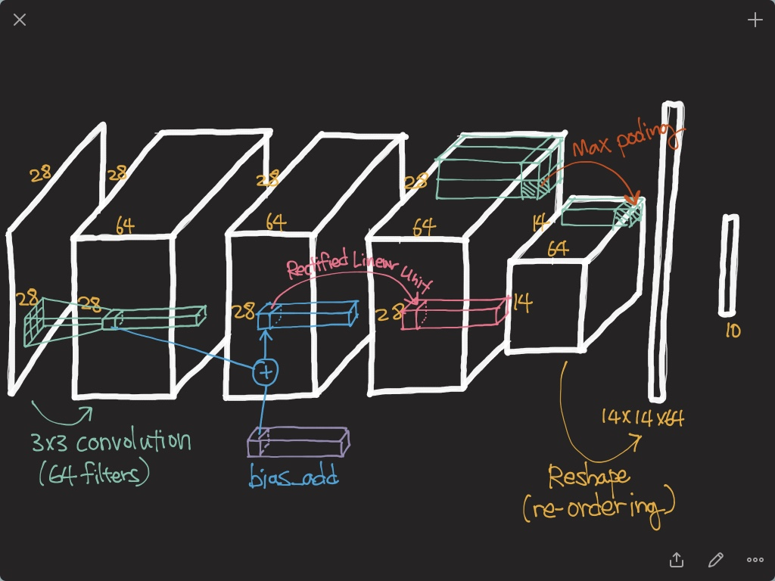

Slide 18
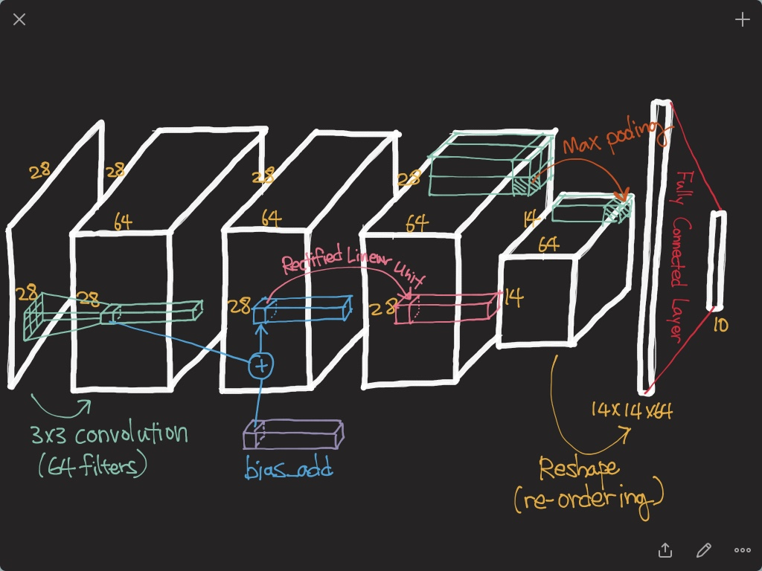

Slide 19
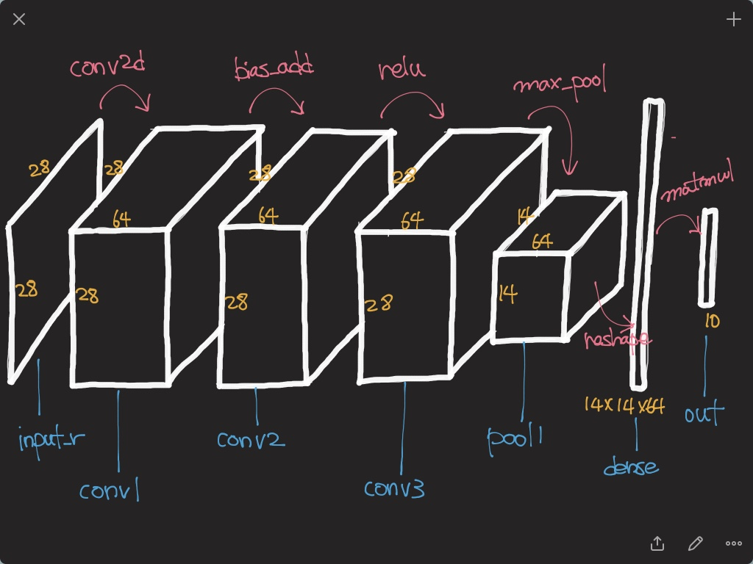

Slide 20
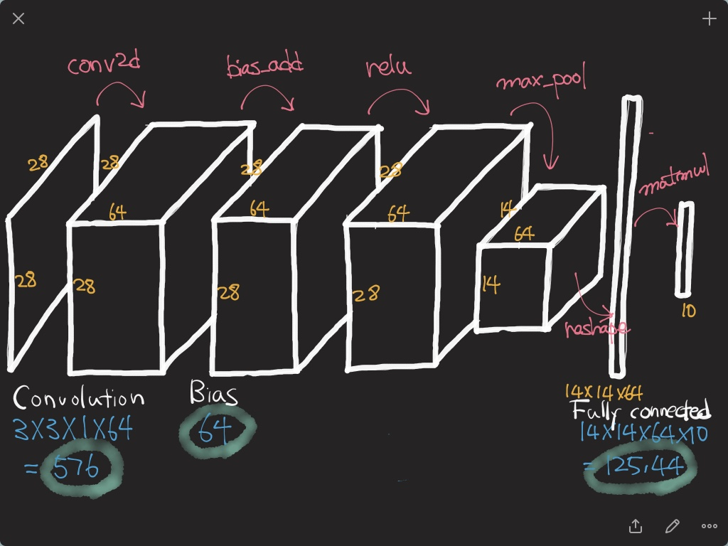
CNN의 파라미터보다 Fully Connected layer의 파라미터의 수가 훨씬 많음 (576 < 125400)
최근 신경망의 트렌드는 파라미터수를 줄이는 추세임
그래서 최근CNN의 경향은 Fully Connected layer를 없에거나 간소화 하는 방향으로 설계된다.

